Slide 1

Old Name - New CLI
why you should look at sqlcmd

Slide 2


Slide 3



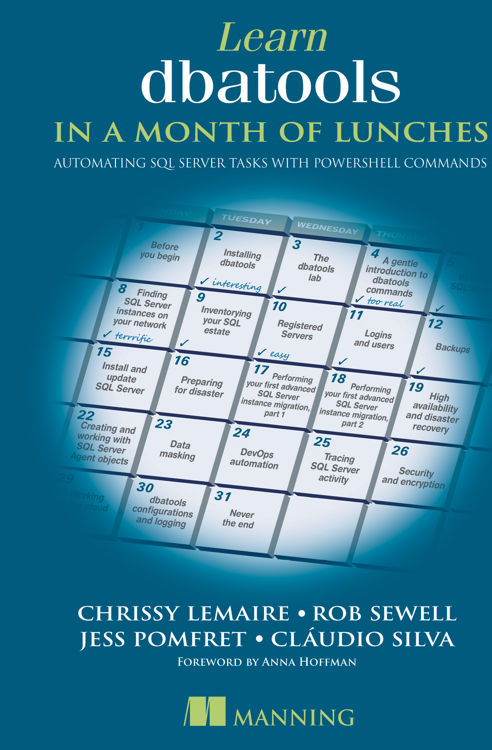


mrrobsewell@outlook.com
Rob Sewell
He/Him
I was a SQL Server DBA with a passion for Powershell, Azure, Automation, and SQL (PaaS geddit?) (And a sense of humour (and a habit for writing inside braces)). Now I just help other people with those (not the braces bit).
SEWELLS CONSULTING LTD
Beard Twizzler
MICROSOFT MVP
DATA PLATFORM 2020 - 2022
Cloud and data center management 2017 - 2022
INTERESTS
cycling, automation, Community
robsewell.com

Slide 4
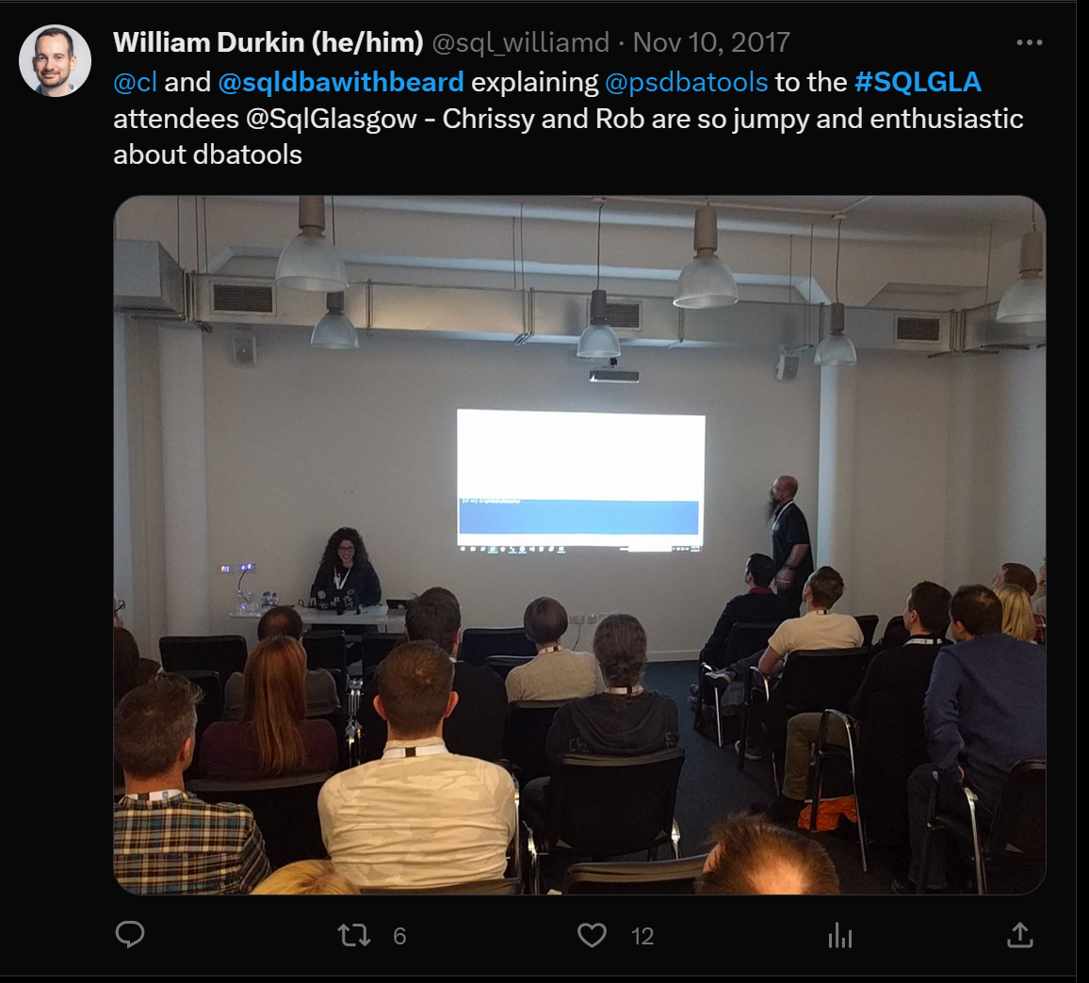

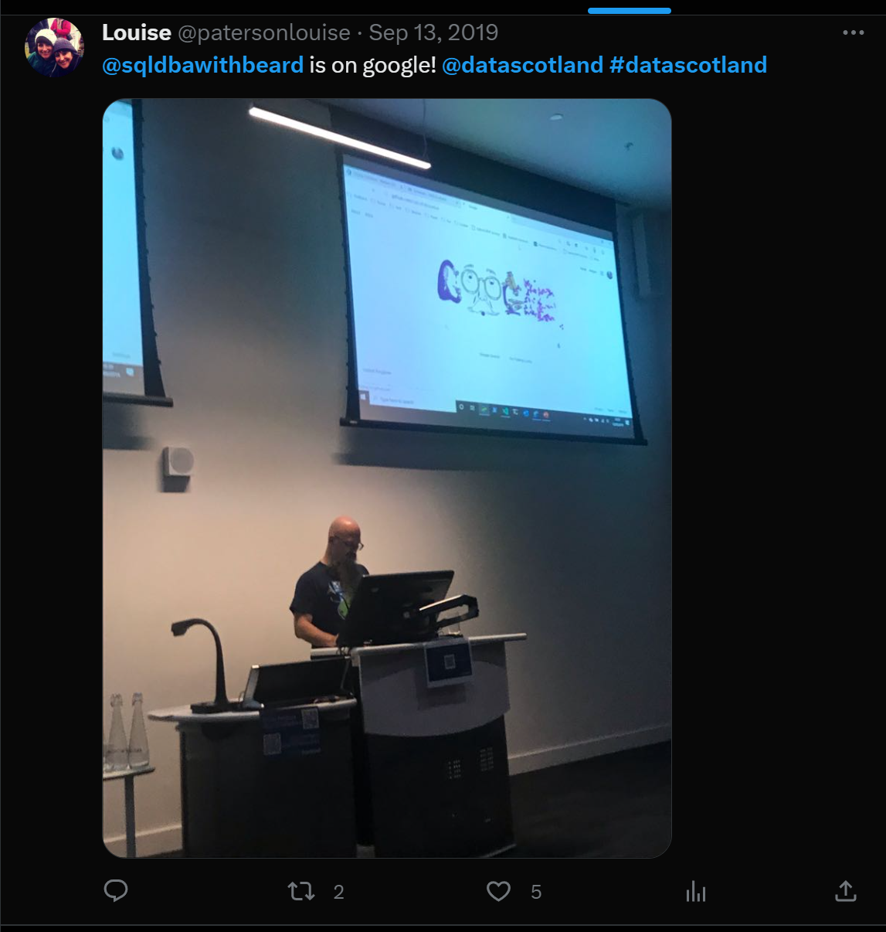

Slide 5
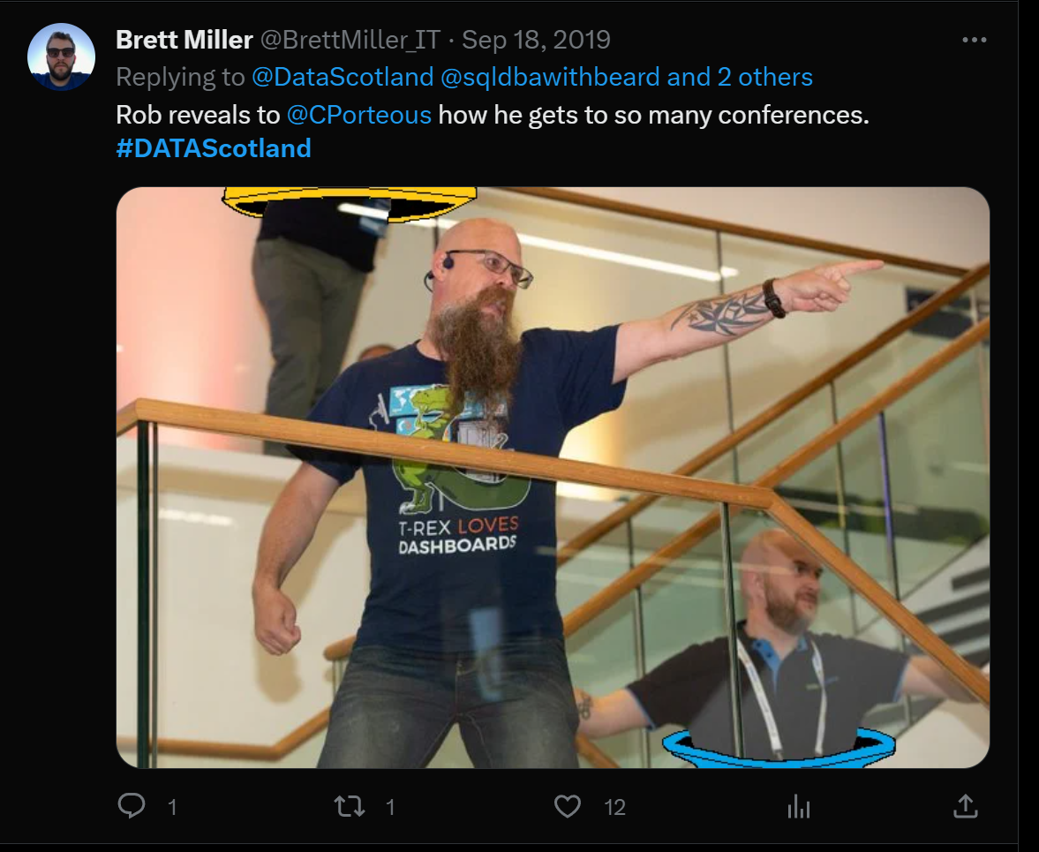

Slide 6







Slide 7


Slide 8

WHAT CAME BEFORE SQLcmd ?
It's a long time ago

Slide 9



Osql & Isql: Old Connectivity Tools
Osql & Isql:
Functionality:
Limitations:
Old command-line tools used to connect to SQL Server databases.
Provided basic functionality for querying and managing databases.
Lacked features such as parameters, DAC Performance
Osql & Isql were the tools Gianluca first used to connect to SQL Server databases.

Slide 10

November 2005 - sqlcmd
Where is this a picture of?
Over 17 years ago - SQLCMD released - Uses ODBC

Slide 11



sqlcmd - Incompatibility

Slide 12

GO-SQLCMD
aka.ms/sqlcmd
forked from go-msqldb
written in Go
compiles into one exe
cross-platform
cross architecture
Shiny and New

Slide 13

Backwards Compatibility
So Close!
So Close!

Slide 14
You said close?
-R (Use client regional settings) will be removed. Go doesn't provide this
-I (enable quoted identifiers) will be removed. (Use SET QUOTED IDENTIFIER OFF)
-P (password) was removed.
-P will be added back following feedback!

Slide 15


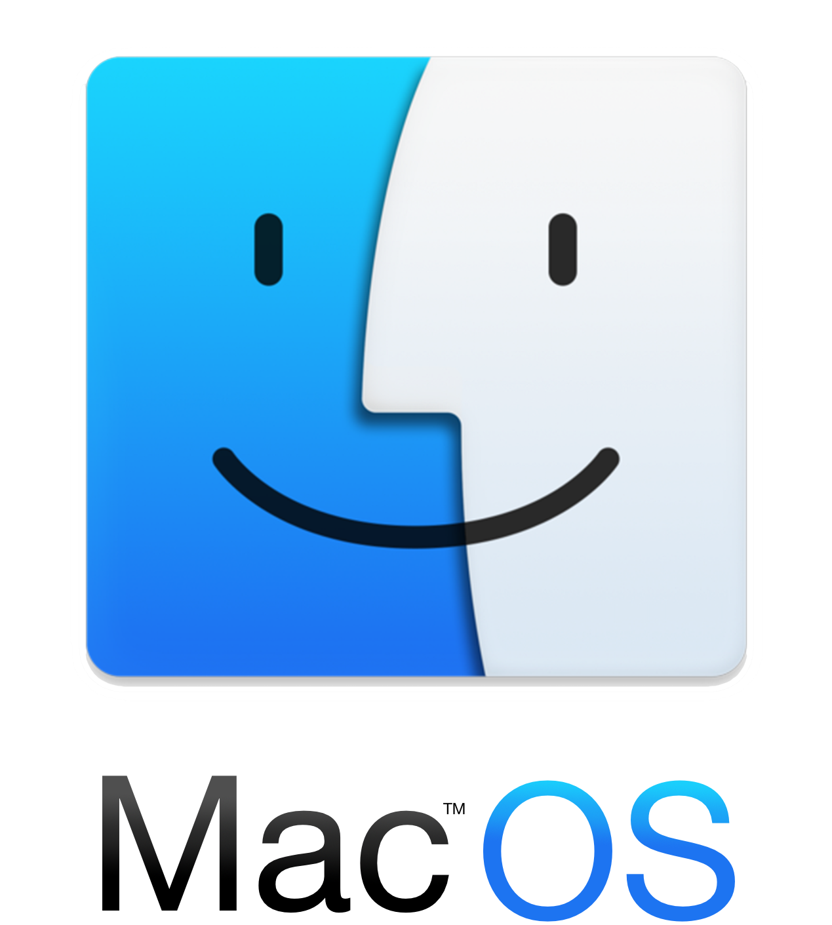

installation
winget install sqlcmd
choco install sqlcmd
brew install sqlcmd
Linux
apt-get install sqlcmd yum install sqlcmd
All major package managers supported

Slide 16


Slide 17


Demo Time

Slide 18


Slide 19



← SESSION
EVENT →

